Slide 1
Helping Hands
By:
Anusha Malla
Briana Jenkins
Daniel Bae
Haythem Abdelkhalek
Trmnit Tesfatsion
Wonjin (James) Choi

Slide 2
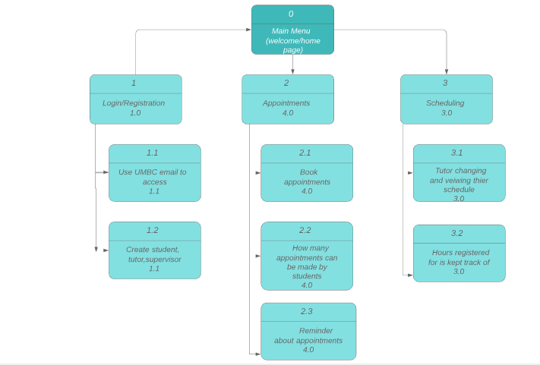
Interface Structure Diagram

Slide 3
Interface Standards
Interface standards are comprised of the basic design elements that are common across the individual screens, forms, and reports within the system. The following selected standards will ensure that the interfaces are consistent across the system.
Interface Metaphor - a concept from the real world that is used as a model for the information system.
Login/ register metaphor: this will be used to symbolize access management software for the app
Calendar metaphor: this will be used to symbolize previous and future appointments that student and tutors register for.
Interface Objects and Actions - fundamental building blocks of the system such as entities and data stores (objects), and commands employed by users (actions). The objects and actions selected are all more general terms that would be simple enough for the end user to understand.
Objects:
Entities: Students, Tutor, Supervisor
Data Stores: Registration, and Scheduling Database
Actions:
“Login” - allows all to get into the app
“Booked Sessions” - allows for the tutor to see their appointments they have
“Contact tutor” - allows the student to talk to their tutor when needed
“Contact Support” - allows supervisor, tutor, or student to talk to support if something goes wrong

Slide 4
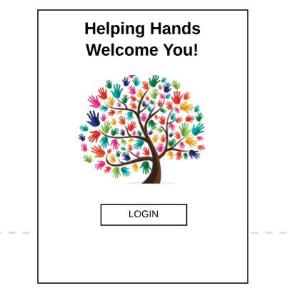
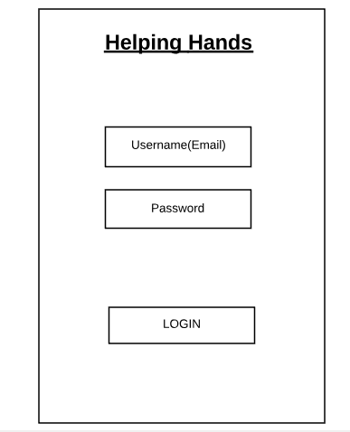
Interface Prototypes

Slide 5
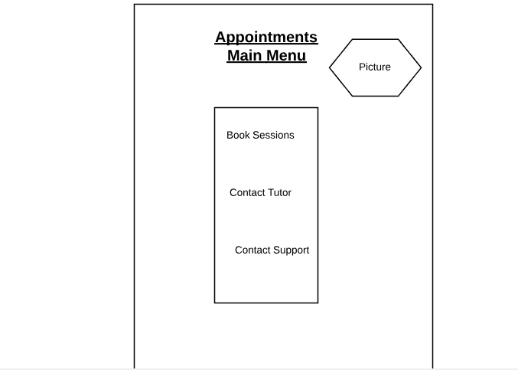
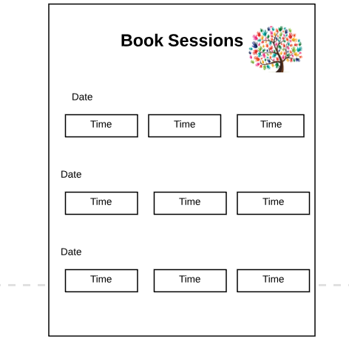
Interface Prototype

Slide 6
Demo
https://appetize.io/app/161e9njn8c9pea37y4g6gwpq2m?device=nexus5&scale=75&orientation=portrait&osVersion=8.1

Slide 7
Team Experience
The team experience throughout the SDLC process was great. We all were able to put our thoughts and heads together to come up with and solve the problem by going through the steps of SDLC. Also we analyzed the process it would take to finish the app and how it would be done. The designing part did not give us an issue, just figuring out which important screens we were going to focus on took a little time. Overall, the cycle helped the group because it helped us focus on one part of the project at a time. As a team, working together in this project has been very rewarding since we get to learn about the SDLC know how to work in an Agile environment.

Slide 8
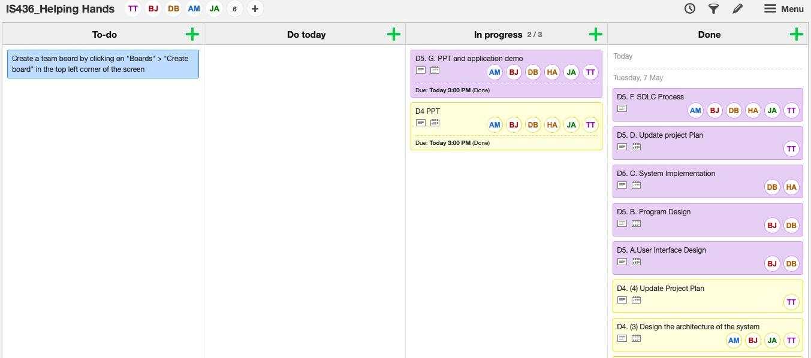
KanbanFlow

Slide 9
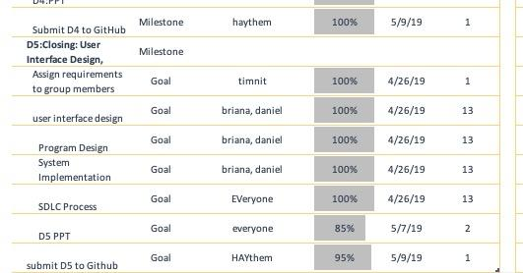
Updated Gantt Chart

Slide 10


Slide 11


